Slide 1

Design of an autonomous energy management agent
for a hybrid microgrid
Prepared by: Julian Banks (BNKJUL001)
Prepared for: Professor Sunetra Chowdhury

Slide 2
Overview
Review
Results & agent’s behavior
Load forecasting
1
3
5
2
4
6
RL environment
Conclusion & wrapping up
Hybrid Microgrid

Slide 3
Review
Hybrid microgrids
AC and DC load
Suite DC nature of renewables
Serve growing DC demand
Energy management systems
(EMS)
Scheduling of energy
Sheduling
Machine learning (ML) forecasts
Autonomy
Reinforcement Learning (RL)
Simulate complex environments
Train autonomous agents

Slide 4
The plan
Hybrid Microgrid
ML-generated forecasting
RL-trained autonomous EMS
Reduced energy costs!

Slide 5
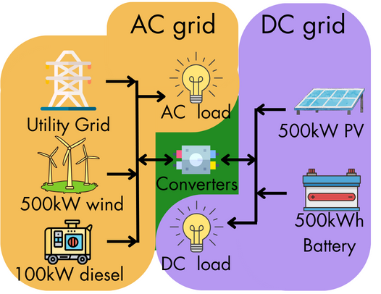
Hybrid microgrid parameters
AC load data
UCT building
DC load data
Simulated

Slide 6
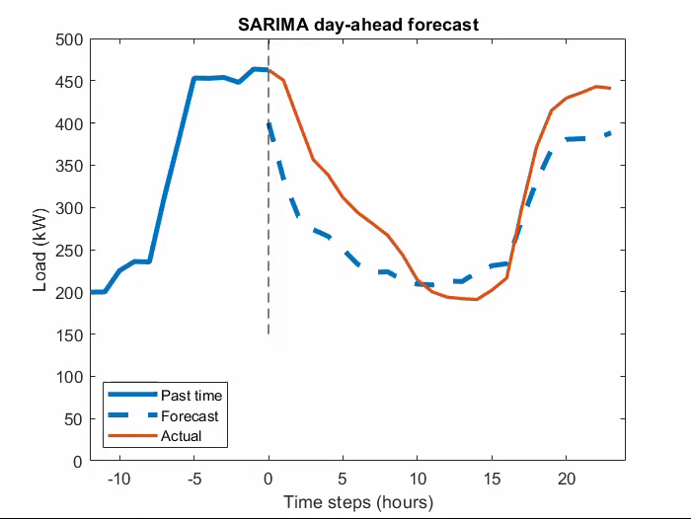
Load forecasting
Evaluated models
LSTM
SARIMA
Neural net
AC mean-per-step MAPE
16.82%
DC mean-per-step MAPE
23.47%

Slide 7
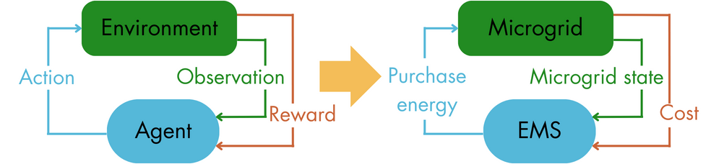
RL environment

Slide 8
Action space
Purchase requested energy
Charge battery with excess
Draw shortfall from battery
Purchase any remaining shortfall
Purchase request
0 – 300 kWh
Reward structure

Slide 9
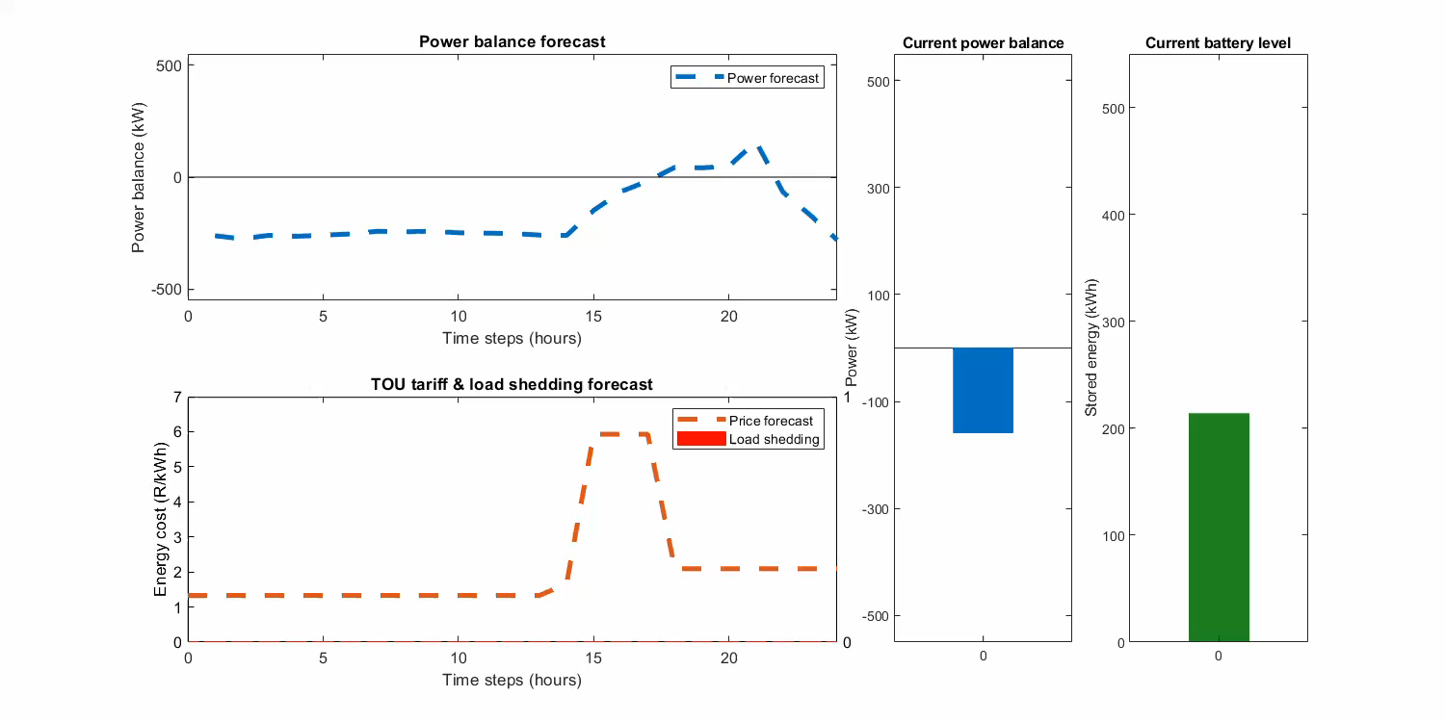
Observation space
24 step ahead forecasts
Power balance
Time of use tariff schedule
Load shedding schedule
Current
Power balance
Battery level
Time of use tariff
Load shedding

Slide 10
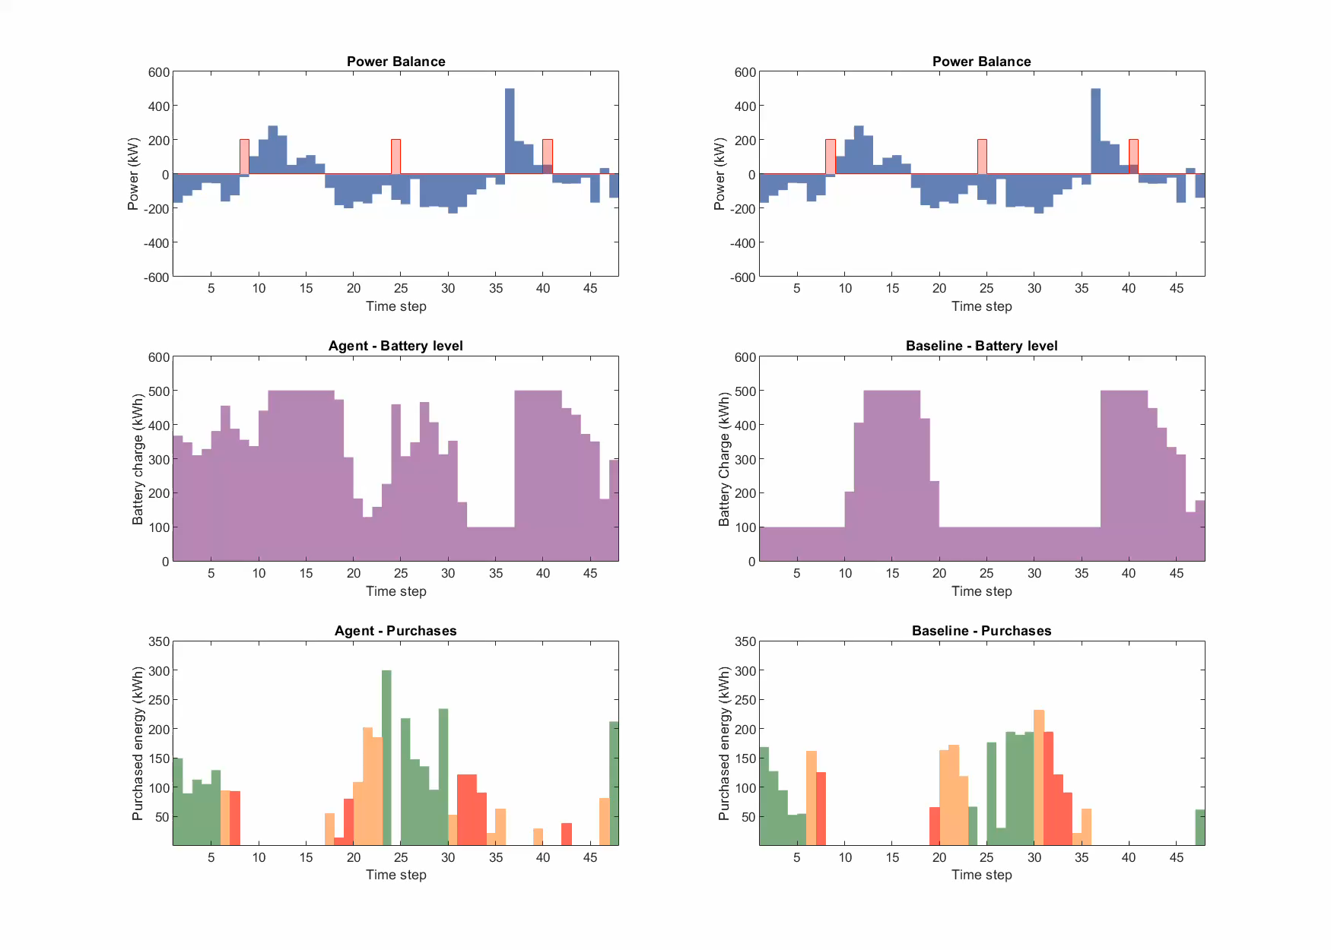
Agent
Baseline
Agent’s
behaviour
Power balance
Battery level
Energy purchases
Peak
Standard
Off-peak

Slide 11
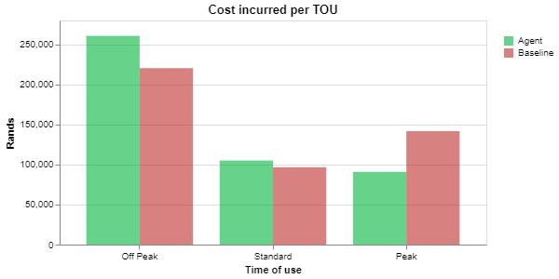
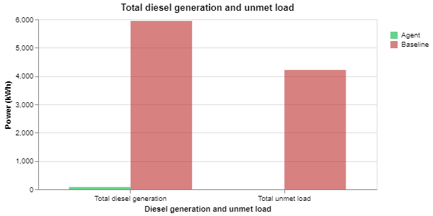
Results
Stable grid
5.38% reduced energy costs
Un-stable grid
6.12% reduced energy costs
98.6% decrease in diesel generation
100% decrease in unmet demand

Slide 12
Conclusion
Hybrid microgrid
Load forecasts
EMS agent
Suitable for RL modeling
Able to meet loads
Economically feasible
16.82% - AC load
23.47% - DC load
Sufficiently accurate for EMS
Saved R52 895 in stable grid conditions
Saved R62 664 in unstable grid conditions
Eliminated unmet demand
Reduced diesel generation

Slide 13


Future work
Generation forecasts
ML-generated energy production
Weather API’s
RL Training
Explore different algorithms
Tune hyperparameters
Real-world integration
Test feasibility of SCADA integration

Slide 14
Thanks
Special thanks to my supervisor, UCT, and everyone who supported me along the way.

